Slide 1


Slide 2
Core Competencies
Provide breastfeeding education and support at critical points in the early postpartum period.
Assess the breastfeeding mother and infant at critical points in the early postpartum period and provides appropriate support and/or referrals as needed.
Explain to new mothers the enhanced food packages available for breastfeeding mothers and infants.

Slide 3
Learning Objectives
Identify appropriate breastfeeding messages for mothers during the early postpartum period.
Explain how the infant’s position and latch onto the breast can affect breastfeeding success.
Explain why WIC does not routinely provide infant formula to breastfed infants less than one month of age.
State how the food packages provide incentives to help mothers initiate and continue to breastfeed.

Slide 4
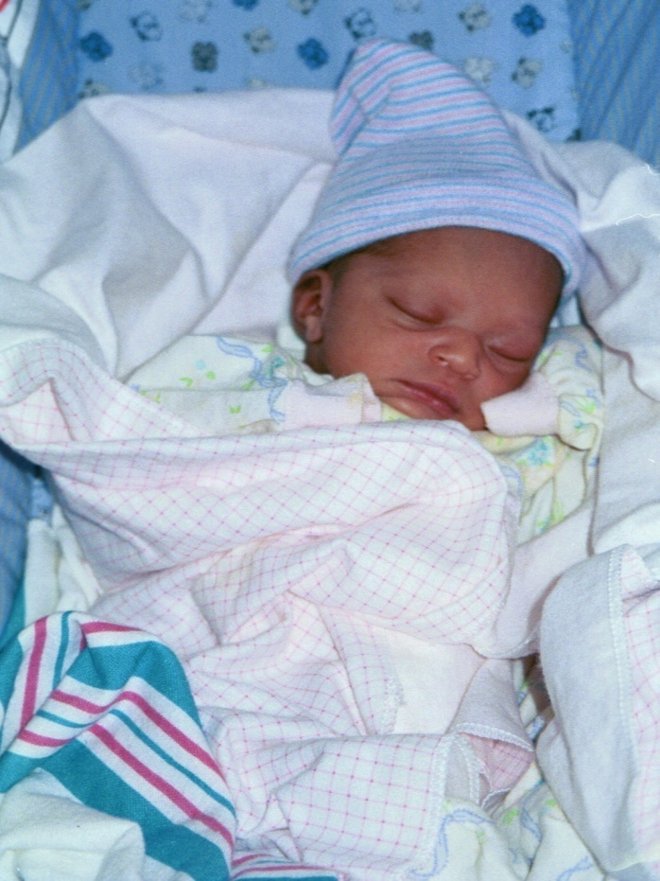
Baby is Home…Now What?
Challenges of early days
Recovery from childbirth
Hormonal shifts
New responsibilities
New ways of viewing her body
Sleep deprivation

Slide 5
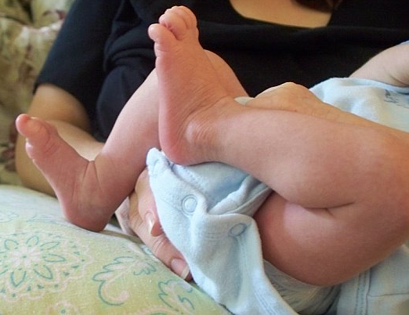
Solving Concerns While They Are Small
Breastfeeding challenges can usually be prevented
Manage challenges quickly with support, options

Slide 6
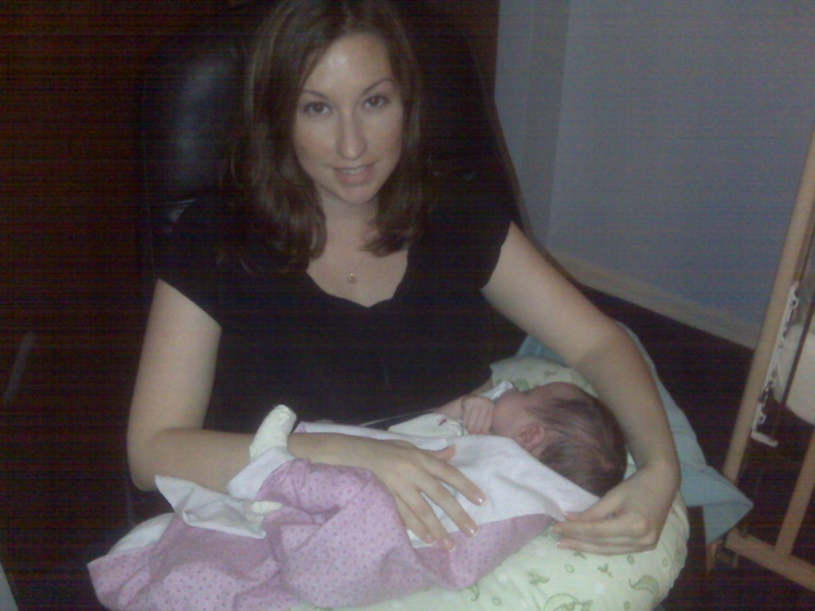
Adjusting to Breastfeeding
First two weeks:
Critical learning period
Mothers need to know
breastfeeding gets easier

Slide 7


Gardening for Beginners

Slide 8
Getting It Right From the Start
Timely assistance
Identify, address barriers
Affirm mother’s concerns

Slide 9
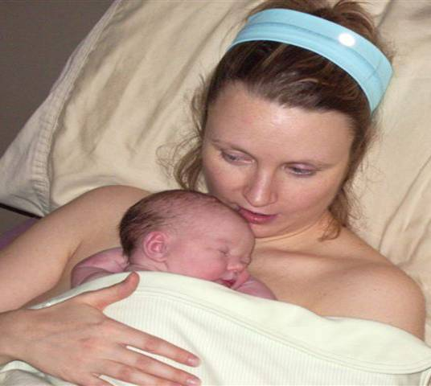
The First Hour: The Importance of Skin-to-Skin
Skin-to-skin
Warms baby
Decreases pain, stress
Helps immune system
Reduces infant crying
Improves attachment, breastfeeding
Used with Permission from ILCA

Slide 10
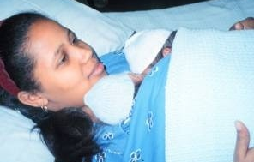
Learning Through All Five Senses
Skin-to-skin contact engages all the senses:
Touch
Hearing
Sight
Smell
Taste

Slide 11


The First Hour: Building Skills and Confidence
Importance of
Rooming in
Exclusive breastfeeding
DVD: “Baby-Led Breastfeeding”
Handout 7.1: “Baby-Led Breastfeeding”
Available from ILCA at www.ilca.org

Slide 12
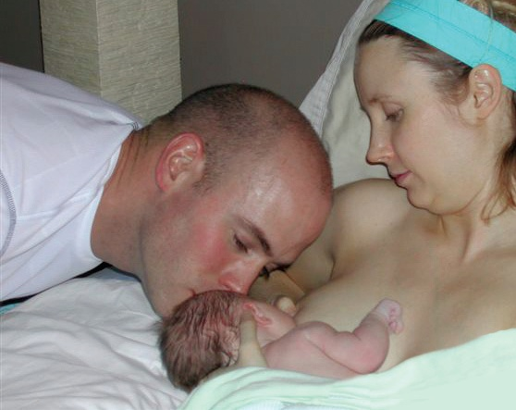
Success In the First Few Days
Skin-to-skin with baby
Avoid separation
Frequent feedings (8-12 times/day)
Delay first bath
Avoid artificial smells
Delay visitors
Used with Permission from ILCA

Slide 13
Breastfeeding Should Not Hurt
Baby’s position and latch at the breast is the key to mom’s comfort
Pain is a red flag to try something different and call for help
Yield to the WIC Designated Breastfeeding Expert if mother reports pain

Slide 14
Breastfeeding Comfortably
One position does not fit all breastfeeding needs
Make sure mother is comfortable
Pillows if needed
Some mothers like to support their breast
Biological Nurturing
Mom semi-reclines/reclines
Mom places baby prone on top of her body (working with instead of against gravity)

Slide 15
Signs of a Good Latch
Baby’s chin is not tucked in to his chest
Baby’s mouth open wide, lips flanged
Baby’s tongue is extended
Mother hears and sees swallowing
Mother is free of pain

Slide 16
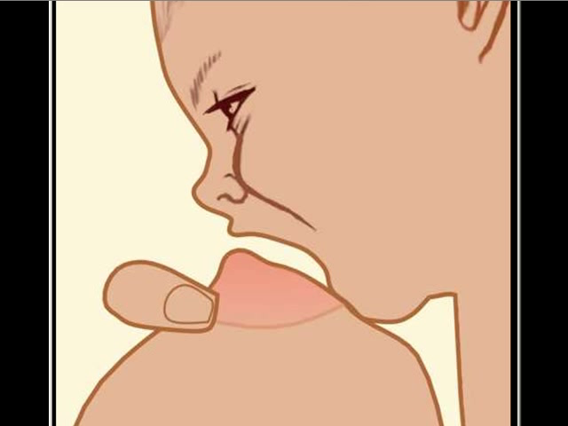
Animated Latch
©Peter Mohrbacher. Used with Permission.

Slide 17
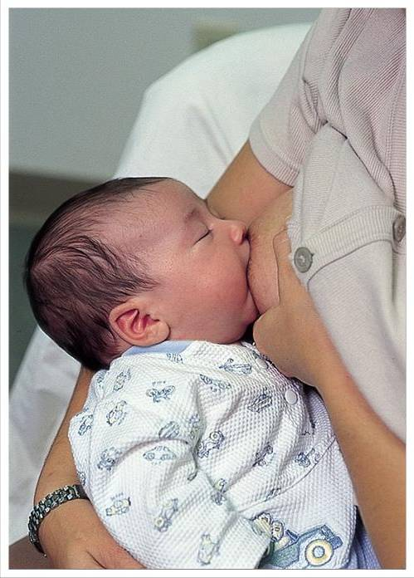
Other Position Options: Cradle Hold

Slide 18
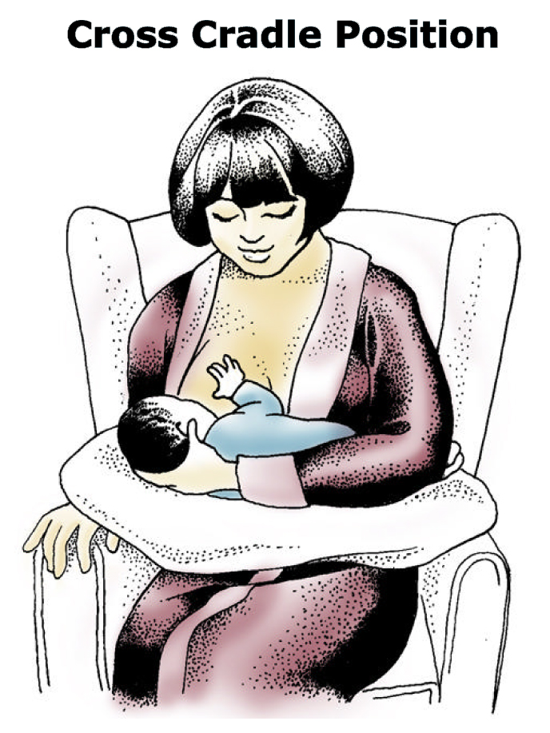
Cross-Cradle Hold

Slide 19
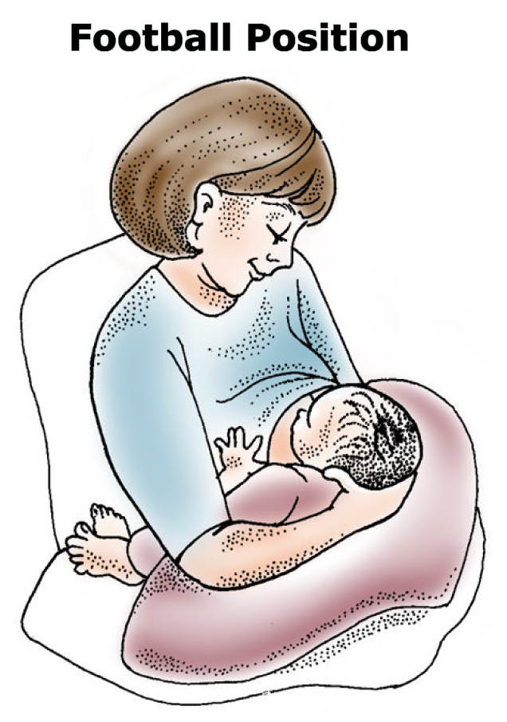
Clutch Hold

Slide 20
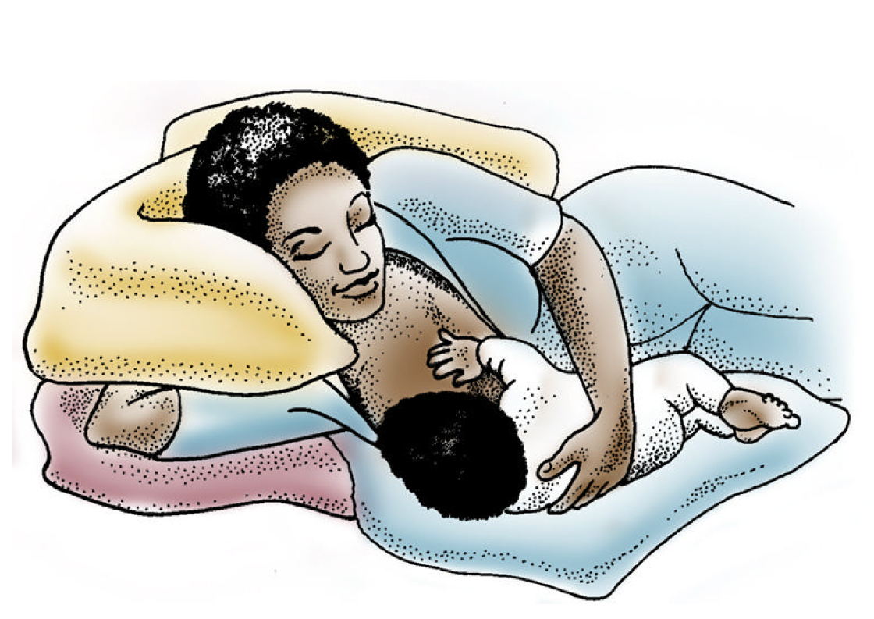
Sidelying

Slide 21
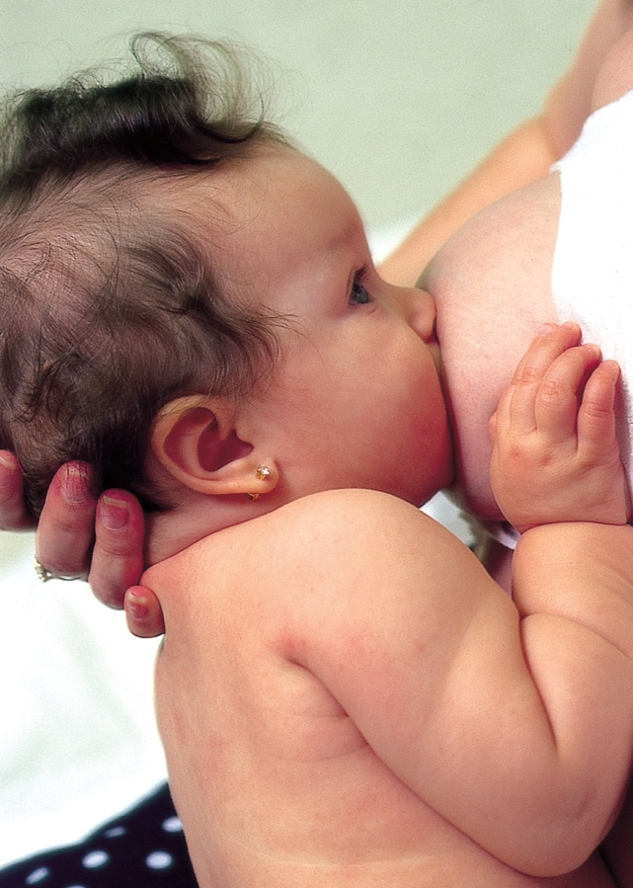
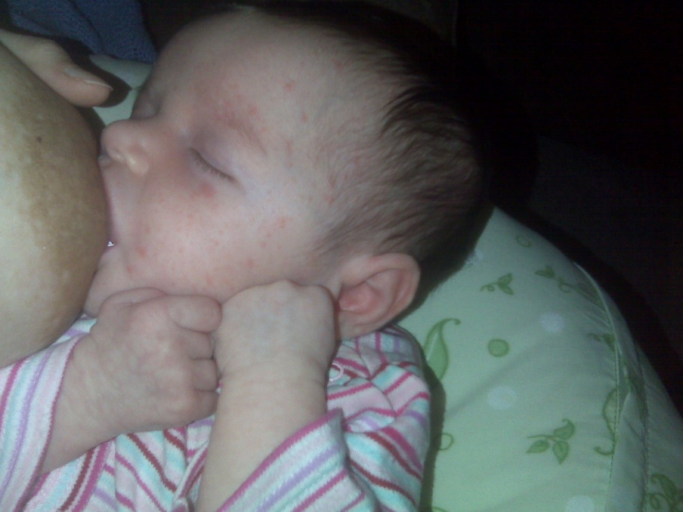
Making Small Adjustment Suggestions

Slide 22

Helping Mothers Build Confidence in Their Milk Production
Breastfeed “early and often”
Supply and Demand
Baby’s stomach doesn’t hold very much
Feeding patterns of breastfed infants are different

Slide 23
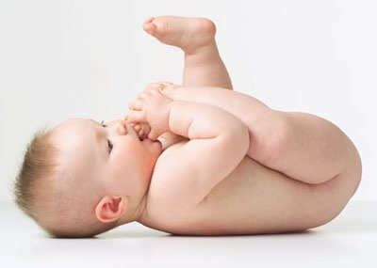


Baby’s Hunger and Satiety Signs
Hunger Signs
Early signs (sucking on hand, rooting, head and mouth movements)
Late signs: Crying
Babies born early may not show strong feeding signs
Signs of Satiety
Baby ends the feeding on his own
Baby’s hands relax; may drift off to sleep

Slide 24
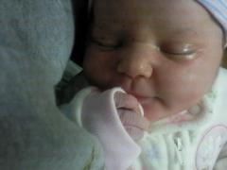
Tips for Assisting a Sleepy Baby
Stroke baby’s cheek
Hold baby in an upright position
Massage baby
Talk to baby
Undress or change baby’s diaper and put him skin-to-skin with Mom
Breast compression

Slide 25

Other Reasons Babies Cry
Fussiness in the early days often taken to mean mom’s milk isn’t enough
Babies have a strong need to be held
Cluster feedings are normal
Sucking needs are strong

Slide 26
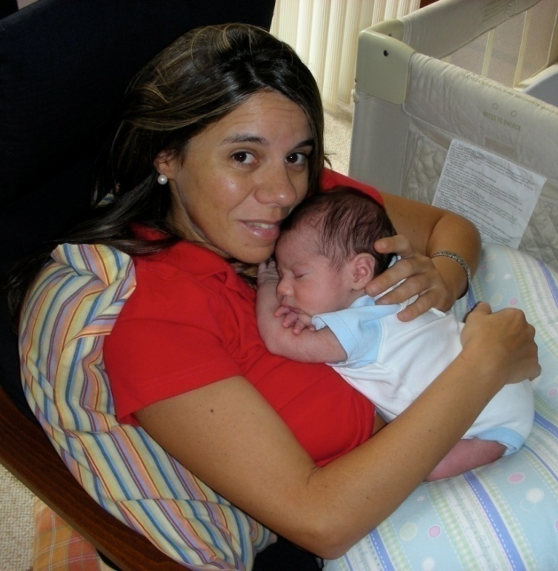
Building Confidence: Ways to Know Baby Is Getting Plenty of Milk
Gains weight
Baby breastfeeds 8-12/day
Wakes to feed
Shows signs of being satisfied
Mom hears baby swallowing
Soiled diapers:
--3/day first 3-5 days of age
--3-4/day by 5-7 days of age
Ask Mom about her breasts

Slide 27
Addressing Concerns About Infant Weight
Weight checks
Some weight loss is common
Mother should call for help when:
Weight loss > 7% of birth weight
Baby losing weight after mature milk production begins
Baby still has black, tarry meconium diapers by Day 5

Slide 28
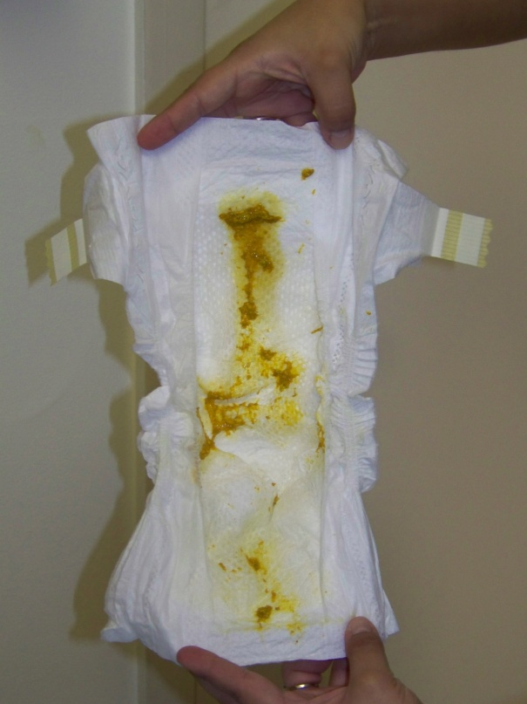
Output for the Breastfed Baby
Mom can keep track of soiled and wet diapers
Let mom know what to expect urine and bowel movements will look like
Short, simple messages:
If it’s coming out,
it’s going in

Slide 29
Baby’s First Week: Breastfeeding Record
Handout 7.2: “Infant Feeding Log”

Slide 30
Other Concerns for New Mothers
Focus: Getting off to a good start
Go easy on activities and accept help
Rest and limit visitors
Make food choices based on My Pyramid Plan for Moms
Baby blues are common in early weeks
Questions and concerns are normal

Slide 31
Avoid Formula Supplementation
WIC Food Packages designed to protect mother’s intentions to breastfeed.
Let mom know supplements are unnecessary and can interfere with her milk production.
Discuss fears she may have, troubleshoot reasons mom lacks confidence.
Advise mother that WIC does not routinely provide infant formula to breastfed infants less than one month of age.
Refer her for breastfeeding support.

Slide 32

Show Me!
DVD: “Show Me Video Vignettes”
Handout 7.3: “Show Me Video Vignettes: Talking to a New Breastfeeding Mother”

Slide 33
Common Concerns: Sore Nipples
Sore nipples are common but not normal
Can be prevented or resolved with quick help
Sore nipples is a common reason for early weaning
Common causes
Incorrect latch or position
Baby has had other nipples
Incorrect use of a breast pump

Slide 34
What Mom Needs to Hear
Affirmation
“What a great mom you are for sticking with it”
Education
“There are solutions that can help you feel more comfortable.”
Yield immediately to the WIC Designated Breastfeeding Expert

Slide 35
Common Concerns: ENGORGEMENT
Mother may say her breasts are hard, painful, hot and baby refuses to latch
Causes
IV fluids in hospital
Missed feedings
Supplementation (e.g., formula, water, expressed breast milk, etc.)

Slide 36
The Domino Effect
Engorgement can lead to:
Diminished milk production
Reduced milk flow to baby
Plugged ducts
Breast infection
Premature weaning

Slide 37
What Mom Needs to Hear
Affirmation
“I can see you are in a lot of pain. WIC can help you work through this.”
Education
“There are solutions for quick relief.”
Yield immediately to the WIC Designated Breastfeeding Expert

Slide 38

Talking With Mothers About WIC Food Packages
WIC’s food package incentive for breastfeeding mothers
Baby gets mother’s priceless breastmilk
Mom gets extra foods and support from WIC
If mother thinks she needs formula:
Ask how breastfeeding is going
Acknowledge her concerns
Explain how formula supplementation affects her milk production
Explain that to help her exclusively breastfeed, WIC provides support instead of routinely providing formula in the first month
Yield to the WIC Designated Breastfeeding Expert

Slide 39
Anticipatory Guidance
Breastfeed within the first hour after birth
Position and latch baby comfortably
Follow baby’s hunger and satiety cues
Avoid supplements and pacifiers
Mom can return to exclusive breastfeeding if she has offered formula
Affirm and support her goals

Slide 40
Other Anticipatory Guidance: Vitamin D for Baby
Vitamin D is important for ALL babies, children, and adolescents.
AAP recommends 400 IU Vitamin D drops for breastfed babies beginning with the first few days of life.
Use sunscreen when baby is outdoors.
Yield to the baby’s health care provider.

Slide 41
Application To Practice
Handout 7.4: “Application To Practice: Helping a New Breastfeeding Mother”

Slide 42
Summary
WIC’s support and services give mothers the confidence they need to breastfeed exclusively.
When we help mothers know what is normal and when to call for help, mothers are empowered to reach their breastfeeding goals.

Slide 43

Grow Your Breastfeeding Skills
“My Goals for Breastfeeding Support”
Goal-Setting Flower

